Slide 1


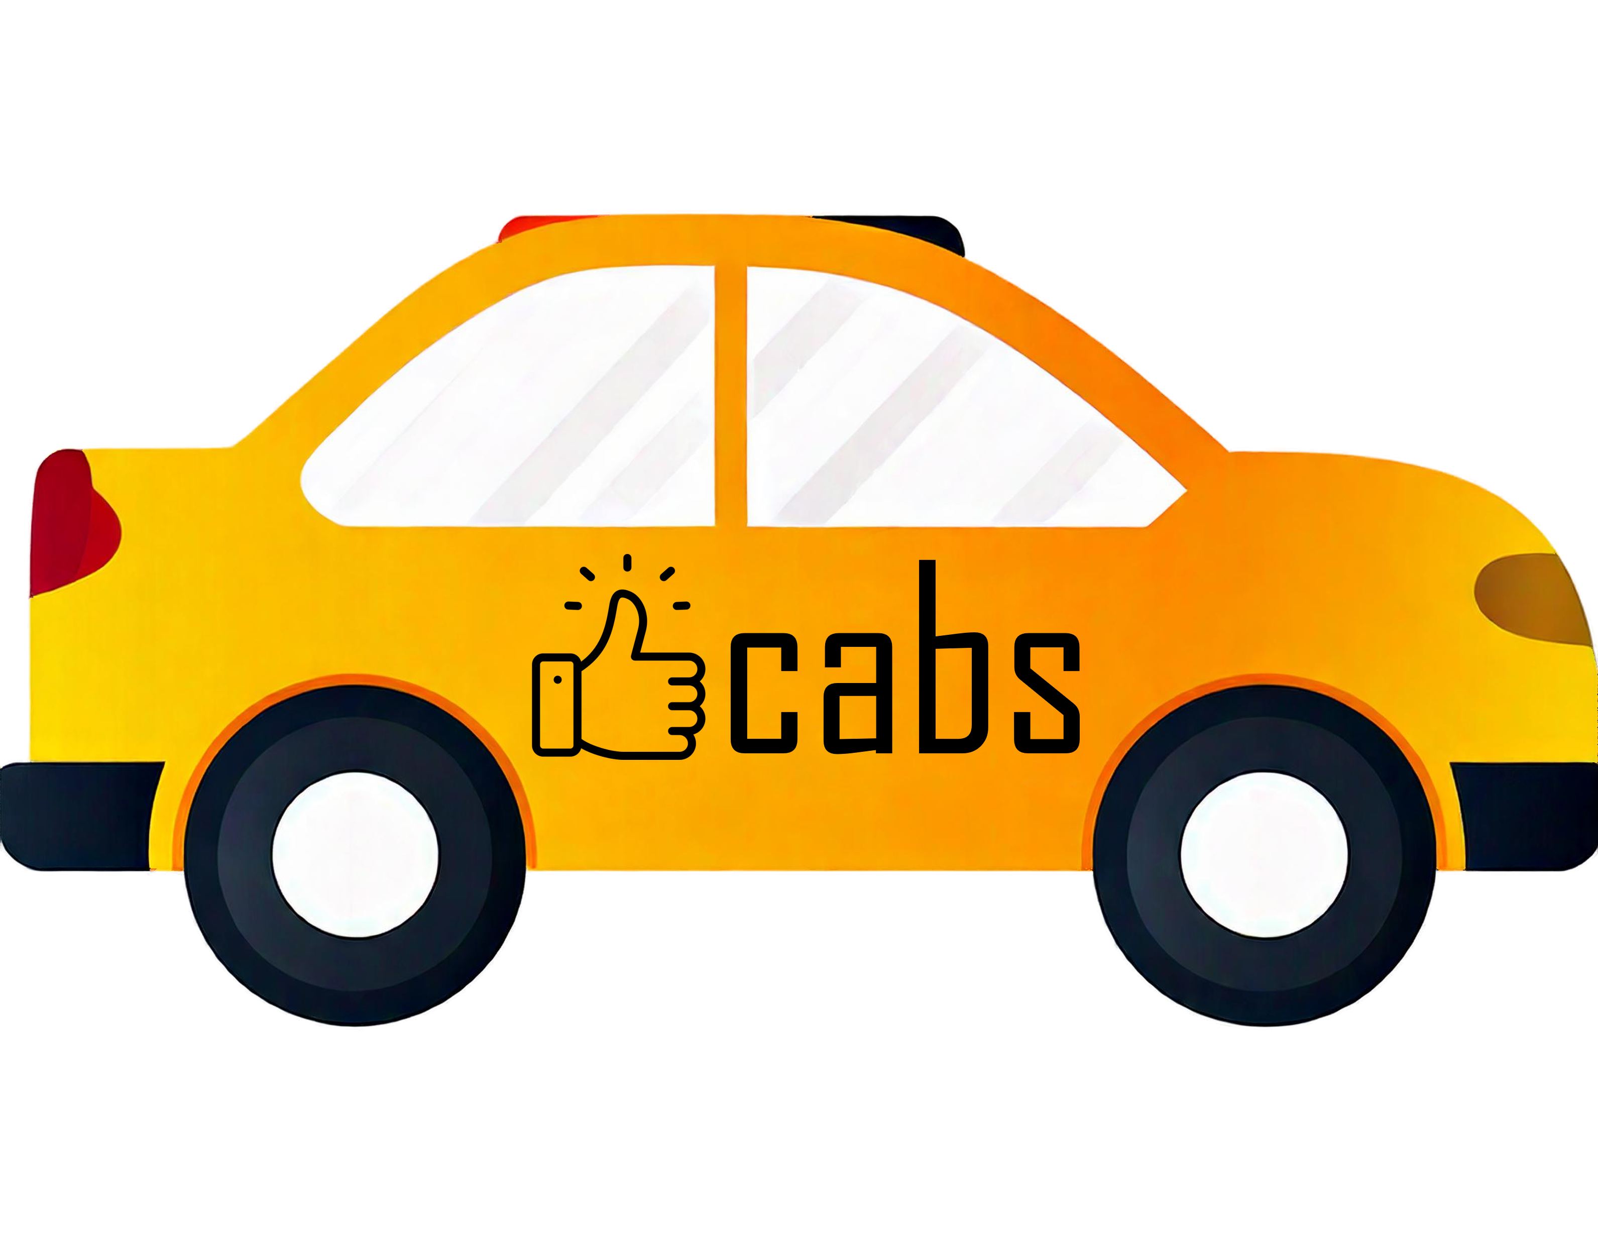
Codebasics
Resume project Challenge #13 Transportation & Mobility Domain
Goodcabs

Slide 2

Agenda
1. Company Overview
2. Problem Statement
3. Primary Analysis
4. Secondary Analysis
5. Business Requests
6. Dashboard Overview
7. Recommendations

Slide 3

Company Overview
Established Presence
Unique Focus
Founded 2 years ago, Goodcabs has quickly gained a strong foothold in the Indian market.
Concentrates on tier-2 cities, filling a gap in the transportation sector.
Driver Support
Passenger Satisfaction
Committed to helping local drivers make a sustainable living in their hometowns.
Ensures excellent service to passengers, balancing driver welfare with customer needs.

Slide 4



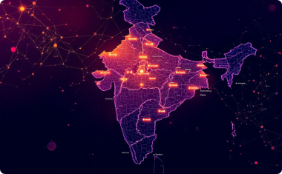
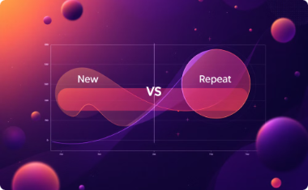
Problem Statement
The insights will directly influence strategic decisions by the Chief of Operations.
Trip Volume
Passenger Satisfaction
Repeat Passenger Rate
Goodcabs aims to assess its performance
in trip volume growth.
Improving passenger satisfaction
is a key initiative.
The repeat passenger rate
is crucial for sustainability.
Trip Distribution
New vs. Repeat Passengers
Goodcabs is assessing its trip
distribution across cities.
Balancing new and repeat passengers
is a strategic goal.

Slide 5
Primary Analysis

Slide 6
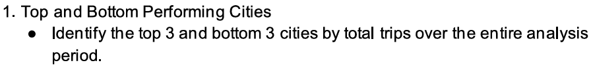
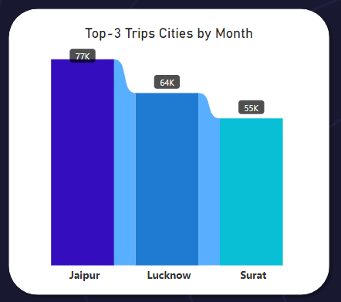
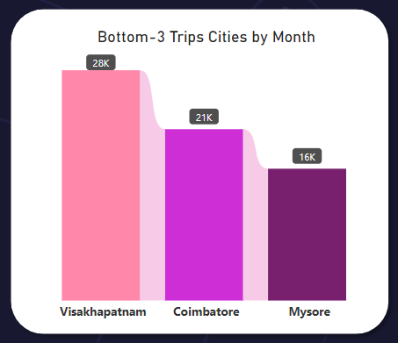
Primary Analysis Q1
Key Insights
Top-Performing Cities: Jaipur leads with 77K trips, followed by Lucknow (64K) and Surat (55K), indicating strong demand in these cities.
Bottom-Performing Cities: Mysore recorded the lowest trips (16K), followed by Coimbatore (21K) and Visakhapatnam (28K), signaling potential underutilization or lesser demand in these locations.

Slide 7
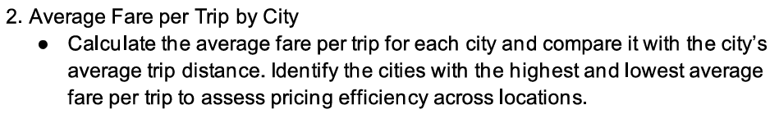
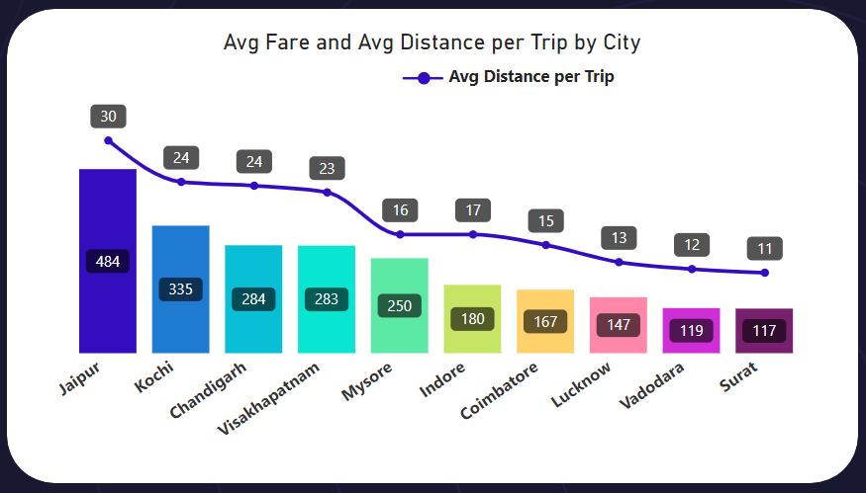
Primary Analysis Q2
Key Insights
Jaipur has the highest average fare per trip (₹484), reflecting premium services or longer average trip distances (30 km).
Surat and Vadodara have the lowest fares (₹117 and ₹119, respectively), despite similar average distances (11-12 km), indicating competitive pricing.
The average fare per trip is not solely determined by distance, as factors like city pricing, demand, trip types, traffic, and costs also influence pricing.

Slide 8
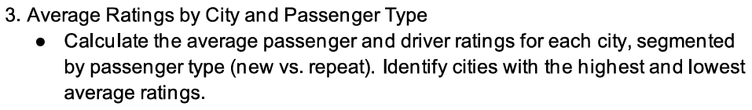
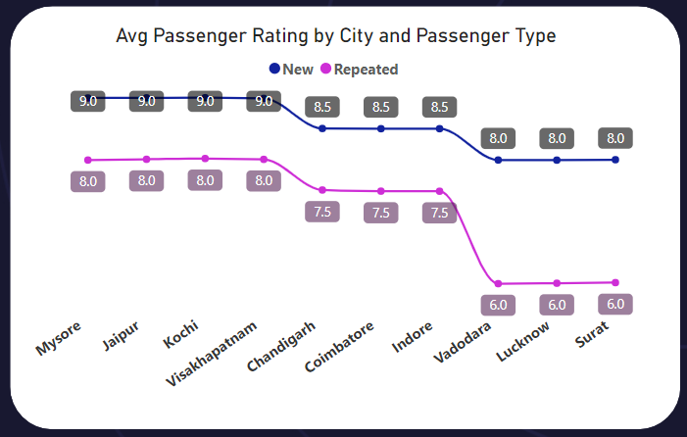
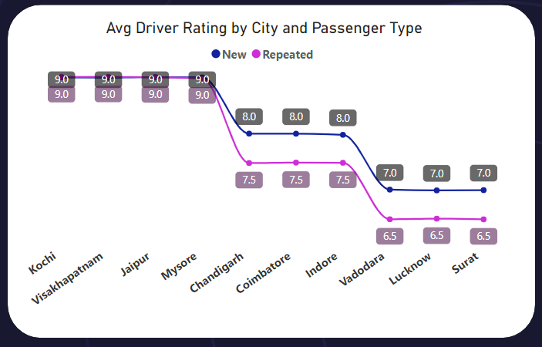
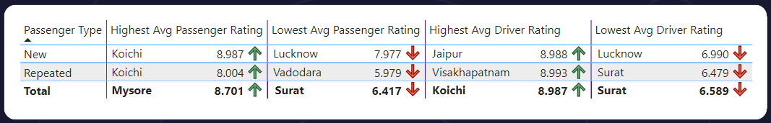
Primary Analysis Q3
Key Insights
1. Highest and Lowest Ratings:
- Mysore has the highest overall avg passenger rating (8.701), while Surat has the lowest (6.417).
- Koichi has the highest overall avg driver rating (8.987), while the Surat has the lowest (6.589).
2. Trends
- New passengers tend to receive and give better ratings.

Slide 9
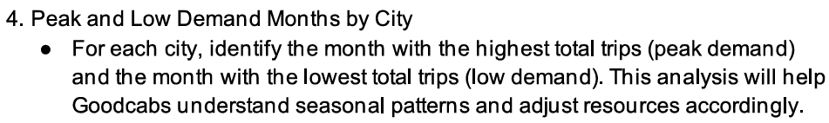
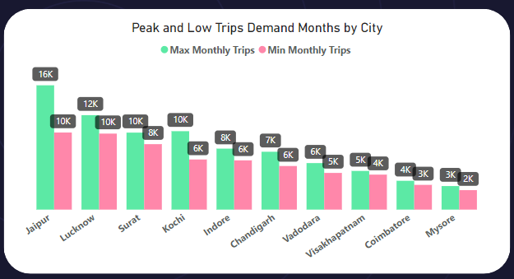
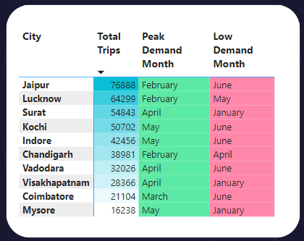
Primary Analysis Q4
Key Insights
- Common Peak Months: February, April and May are peak demand months across multiple cities, indicating higher trip volumes during these periods.
- Common Low Months: January and June are low-demand months, reflecting reduced trip activity in these periods.

Slide 10
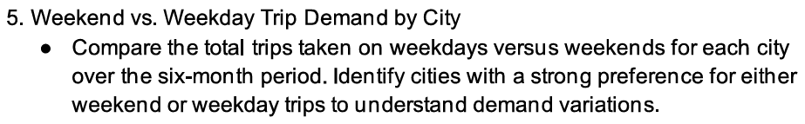
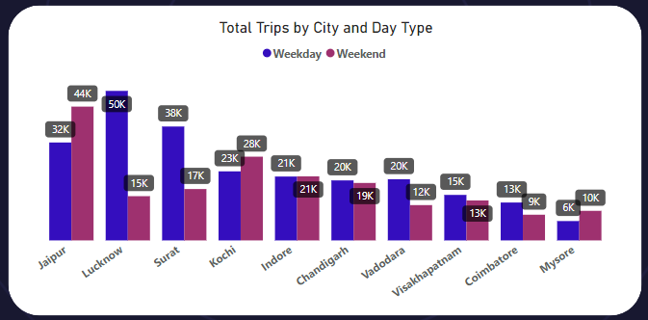
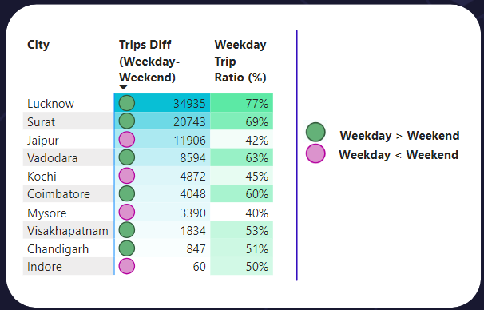
Primary Analysis Q5
Key Insights
Cities like Lucknow and Surat show a significant preference for weekday trips, with weekend trips ratio of 69% and 77%, respectively.
Indore has almost equal demand for weekday and weekend trips, with a minimal difference of 60 trips.

Slide 11
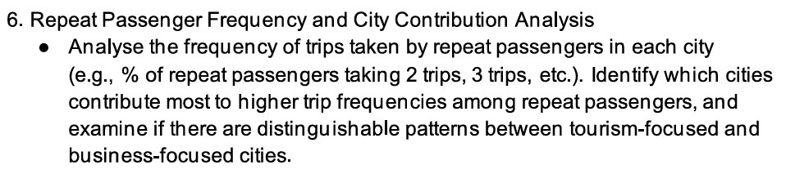
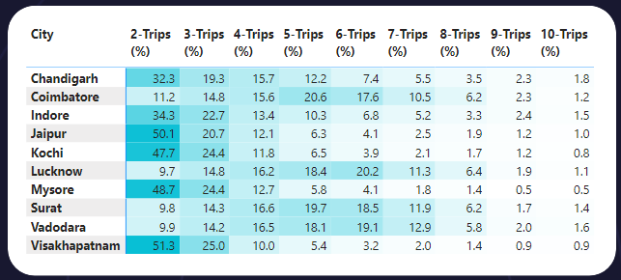
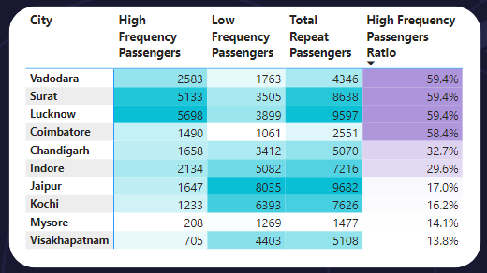
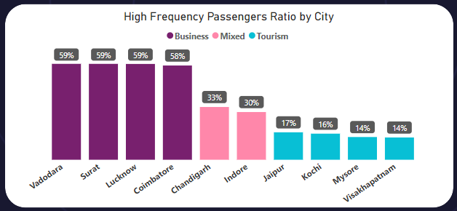
Primary Analysis Q6
Part 1
Repeat Passenger Type
1. High Frequency Passengers: Repeat passengers who had 5+ trips within the given month.
2. Low Frequency Passengers: Repeat passengers who had 2, 3 or 4 trips within the given month.
City Type
1. Business-focused cities:
Tend to have higher contributions from high frequency passengers.
High Frequency Passengers Ratio >= 50%.
2. Mixed-use cities:
Have a moderate balance between high and low frequency passengers.
20% <= High Frequency Passengers Ratio < 50%.
3. Tourism-focused cities:
Tend to have higher numbers of low frequency passengers (1–2 trips).
High Frequency Passengers Ratio < 20%.

Slide 12
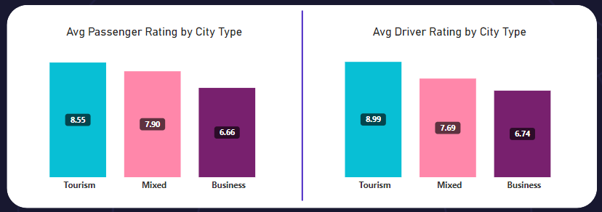
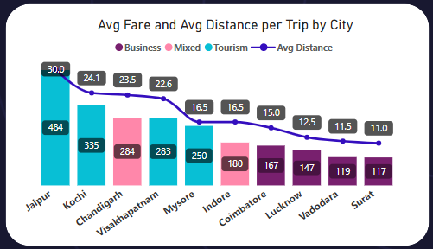
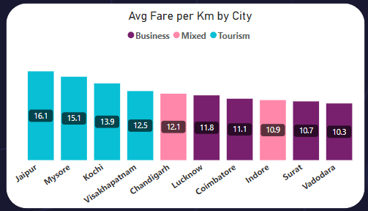
Primary Analysis Q6
Part 2
City Types Patterns
Tourism-focused cities: High passenger and driver ratings, premium fares, and longer trip distances, reflecting positive experiences and leisure-oriented trips.
Business-focused cities: Lower passenger and driver ratings, cost-efficient fares, and shorter trip distances, tailored for frequent, point-to-point travel.

Slide 13
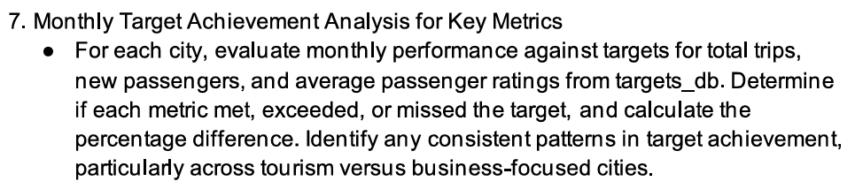
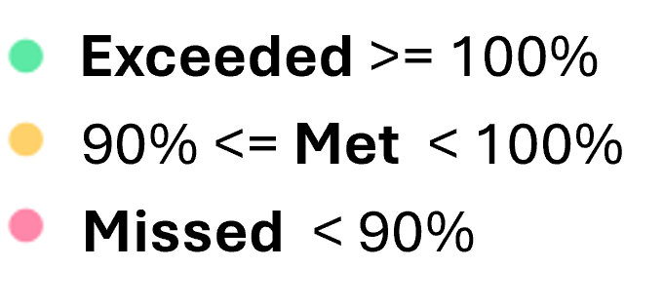
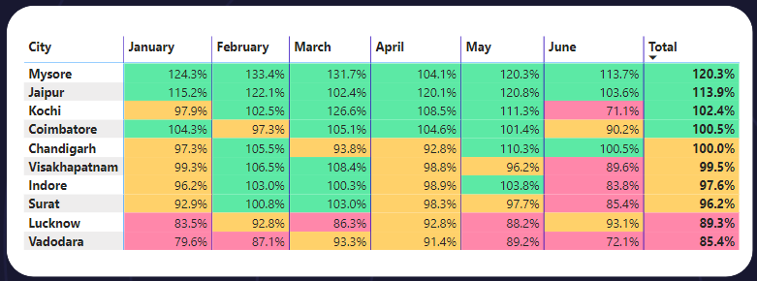
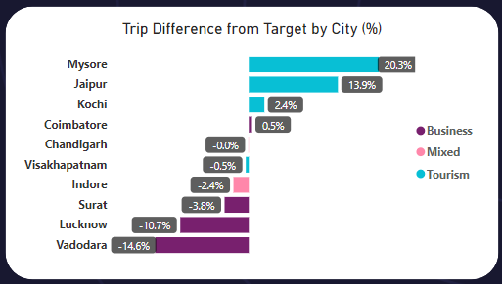
Primary Analysis Q7
Target Trips
Target Trips Analysis Insights
Tourism-focused cities consistently outperformed others in meeting trip targets, highlighting robust demand in leisure-oriented regions.
Business-focused cities such as Lucknow and Vadodara underperformed, suggesting potential demand challenges or overestimated targets.
Mixed cities like Coimbatore and Chandigarh stayed close to their targets, with minimal deviations, reflecting stable performance.

Slide 14
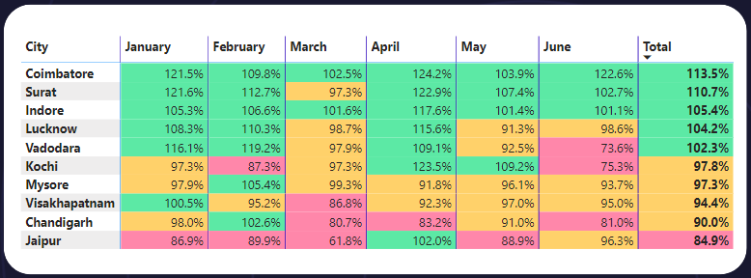
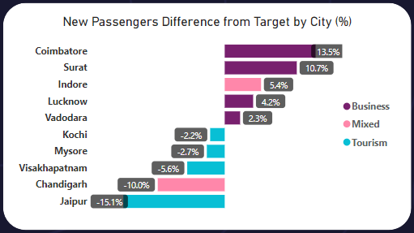
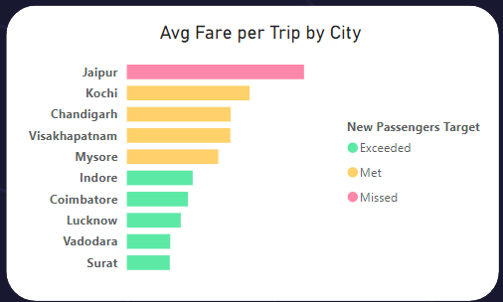
Primary Analysis Q7
Target New Passengers
Target New Passengers Analysis Insights
Business-focused cities like Coimbatore and Surat excel in new passenger acquisition, possibly due to frequent onboarding of business clients.
Tourism-focused cities, like Jaipur, underperformed, reflecting potential gaps in marketing or seasonal fluctuations (e.g., a strong decrease in new passengers in Jaipur in March). Also, premium pricing may deter potential new riders in tourism-heavy cities like Jaipur.
Mixed-focused cities perform well likely due to the benefit from diverse passenger profiles.

Slide 15
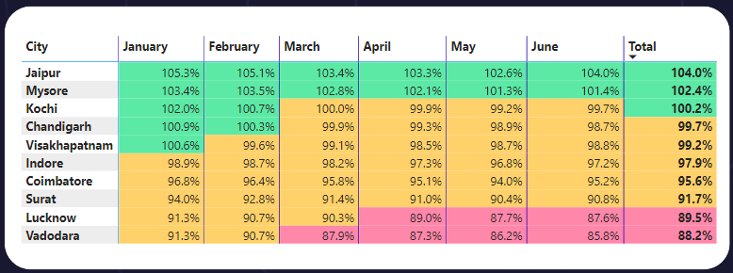
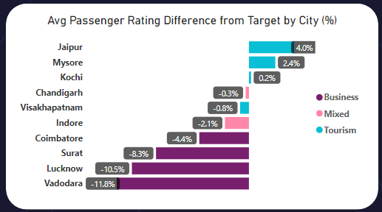
Primary Analysis Q7
Target Avg Pass. Rating
Target Avg Passenger Rating Analysis Insights
Tourism-focused cities such as Jaipur and Mysore exceeded their target average passenger ratings, reflecting high passenger satisfaction in these regions.
Business-focused cities like Vadodara and Lucknow underperformed, indicating potential service quality gaps.
Mixed cities like Chandigarh and Indore closely met their targets, showcasing consistent passenger satisfaction.

Slide 16
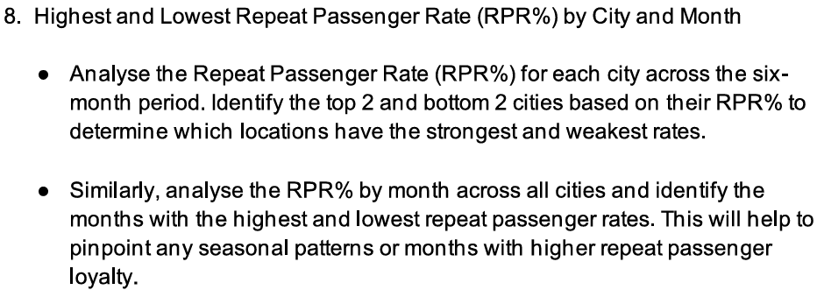
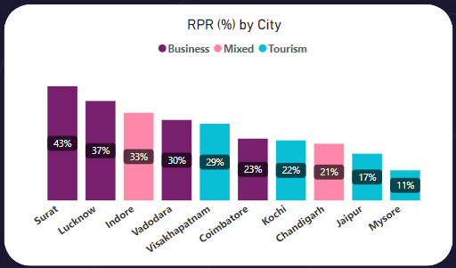
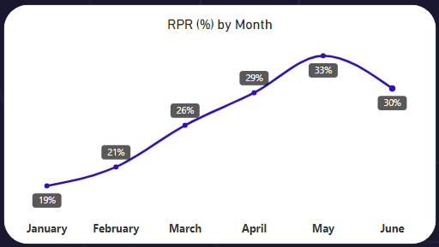
Primary Analysis Q8
Top and Bottom Cities by RPR%:
Highest: Surat (43%) and Lucknow (37%) likely due to consistent service quality or local demand.
Lowest: Mysore (11%) and Jaipur (17%) potentially due to a lack of retention strategies or seasonal tourism focus.
Peak and Low Months by RPR%:
Peak Months: May (33%) and June (30%) indicating possible seasonal demand or increased loyalty during these months.
Lowest Months: January (19%) and February (21%)

Slide 17
Secondary Analysis

Slide 18
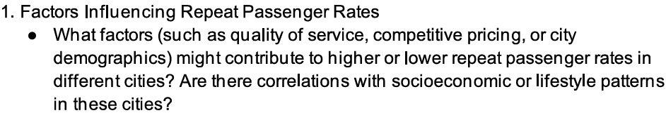
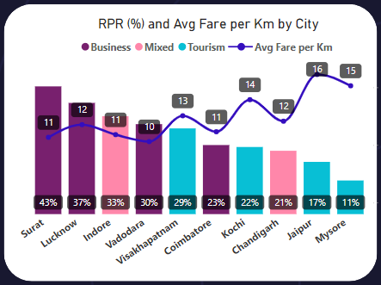
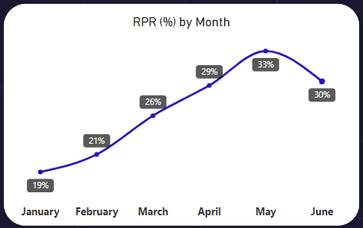
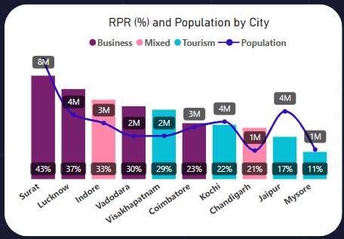

Secondary Analysis Q1
Factors Influencing Repeat Passenger Rates
1. Pricing Competitiveness:
Business cities benefit from cost-efficient fares that support frequent rides, while tourism cities struggle with repeat riders in accordance with higher fares.
2. Demographics and Behavior:
Business cities achieve higher RPR% driven by daily commuters.
Tourism cities face lower RPR% due to leisure travel patterns limiting repeat rides.
3. Socioeconomic Factors:
Highly populated business hubs (Surat) see higher RPR% due to dependence on ride-hailing for daily commutes.
4. Seasonal Trends:
High RPR% in May-June (peak travel).
Low RPR% in January-February (reduced engagement).
P.S. Population data was taken from
StatisticsTimes

Slide 19
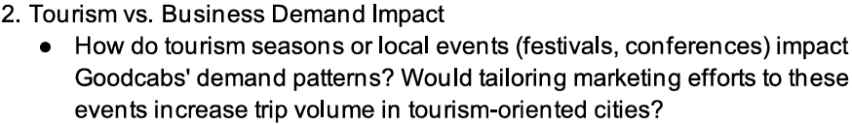
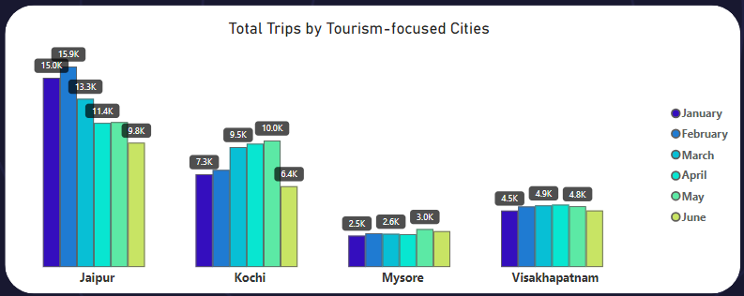
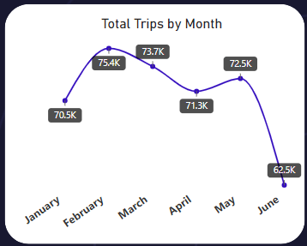
Secondary Analysis Q2
Key Insights
1. Seasonal Peaks:
Tourism cities like Jaipur and Kochi see higher demand in February-May due to cultural activities, aligning with favorable travel seasons.
2. Lowest Demand Month:
June has the lowest total trip volume across cities, likely due to the adverse weather conditions, and the start of the academic year.
3. Marketing Focus:
Promote services during peak tourism months and events, while offering discounts in off-peak months like June to boost demand.

Slide 20
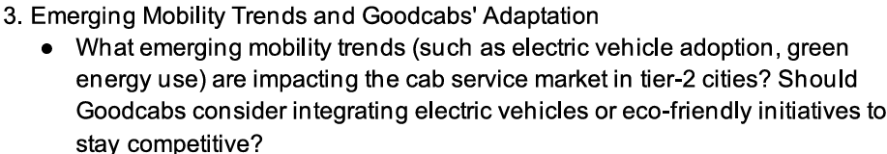
Secondary Analysis Q3
Emerging Mobility Trends & Relevance
1. Trends:
Electric vehicle (EV) adoption, green energy use, and shared mobility are reshaping Tier-2 city markets.
2. Relevance:
EV integration can significantly reduce operational costs in cities with high average trip distances, such as Jaipur.
Aligning with sustainability attracts eco-conscious customers and enhances brand loyalty.
Establishing Goodcabs as a progressive, eco-friendly and forward-thinking brand.
Recommendations
1. Deploy EVs strategically in cities with high trip volumes and longer average distances like Jaipur and Kochi to maximize cost savings.
2. Partner with governments or private players to establish EV charging infrastructure in key locations.
3. Launch eco-friendly marketing campaigns to appeal to environmentally conscious customers.
4. Attract customers through discounts, incentivize passengers to try EV services, raising awareness and building a user base quickly.

Slide 21
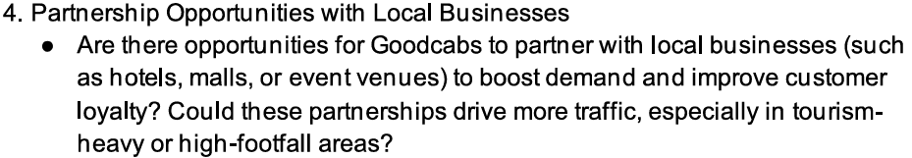
Secondary Analysis Q4
Recommendations
1. Tourism-Heavy Cities (e.g., Jaipur, Kochi):
Partner with hotels, resorts, and event venues to provide seamless transportation for guests.
Offer exclusive packages or discounts for tourists to boost demand.
2. High-Footfall Cities (e.g., Lucknow, Surat):
Collaborate with malls and shopping centers for co-branded promotions and offers.
Establish visibility through kiosks or exclusive pick-up/drop-off zones to attract repeat riders.
3. Impact:
Strengthens customer loyalty and enhances brand visibility.
Drives mutual growth for Goodcabs and partnered businesses.

Slide 22
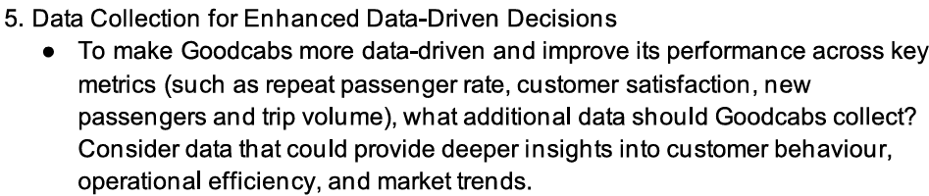
Secondary Analysis Q5
Key Data and Metrics for Collection
1. Customer Behavior & Satisfaction:
Travel purpose (e.g., leisure, business, commute) via optional surveys or app prompts.
Time of travel, travel duration, and peak hours for in-depth operational efficiency and pricing analysis.
Passenger Feedback on service quality, focusing on driver professionalism, vehicle cleanliness, and timeliness.
Trip cancellation reasons to improve user experience.
2. Operational Efficiency:
Vehicle performance: fuel/electric consumption, maintenance needs, and downtime.
Driver activity: trip count per day, hours worked, and average ratings.
3. Market Trends:
Seasonal or event-driven demand fluctuations to predict and meet peak demand.
4. Additional Insights:
High-demand areas or routes to identify expansion or service improvement opportunities.
Loyalty program engagement to assess retention strategies.

Slide 23
Business Requests

Slide 24
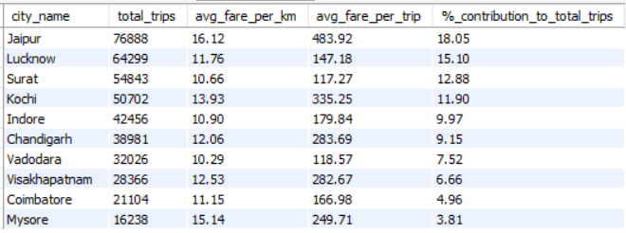
Business Request - 1

Slide 25
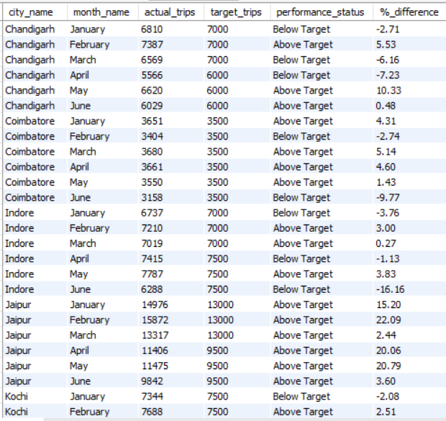
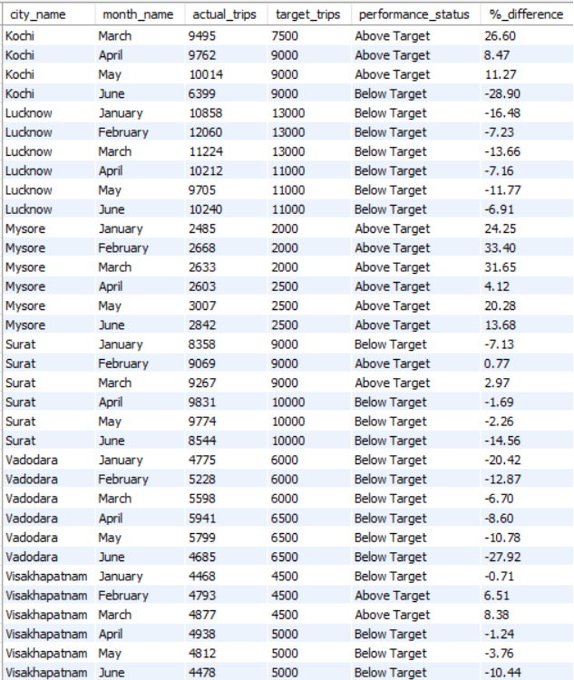
Business Request - 2

Slide 26

Business Request - 3

Slide 27

Business Request - 4

Slide 28

Business Request - 5

Slide 29


Business Request - 6

Slide 30
Dashboard

Slide 31


Slide 32


Slide 33


Slide 34


Slide 35


Slide 36


Slide 37


Slide 38


Slide 39


Slide 40


Slide 41


Slide 42


Slide 43
Recommendations

Slide 44
Overall Recommendations for Goodcabs
1. Enhance Passenger Experience
Introduce loyalty programs and referral bonuses to boost repeat passenger rates and attract new riders.
Ensure consistent service quality through driver training and regular vehicle maintenance.
2. Leverage Local Partnerships
Partner with hotels, malls, and event venues in tourism-heavy cities like Jaipur and Kochi to increase trip volumes.
Collaborate with travel agencies for sightseeing and bundled travel offers.
3. Optimize Pricing and Discounts
Offer competitive fares for daily commutes in business-focused cities like Lucknow and Surat.
Launch discounts for rides in electric vehicles (EVs) to attract eco-conscious customers and promote adoption.
4. Expand Sustainable Mobility
Deploy EVs in high-distance cities (e.g., Jaipur and Mysore) to reduce operational costs and enhance brand appeal.
Highlight sustainability through green marketing campaigns to attract environmentally conscious passengers.
5. Address Seasonal Demand
Intensify marketing efforts during peak tourism seasons while targeting off-peak months like June with special promotions.
6. Use Data for Growth
Track travel duration, route efficiency, and customer feedback to refine operations.

